Slide 1
Structure and Function of Large Biological Molecules

Slide 2
CHE113
Biomolecules:
Proteins
Nucleic acids
Carbohydrates
&
Lipids

Slide 3
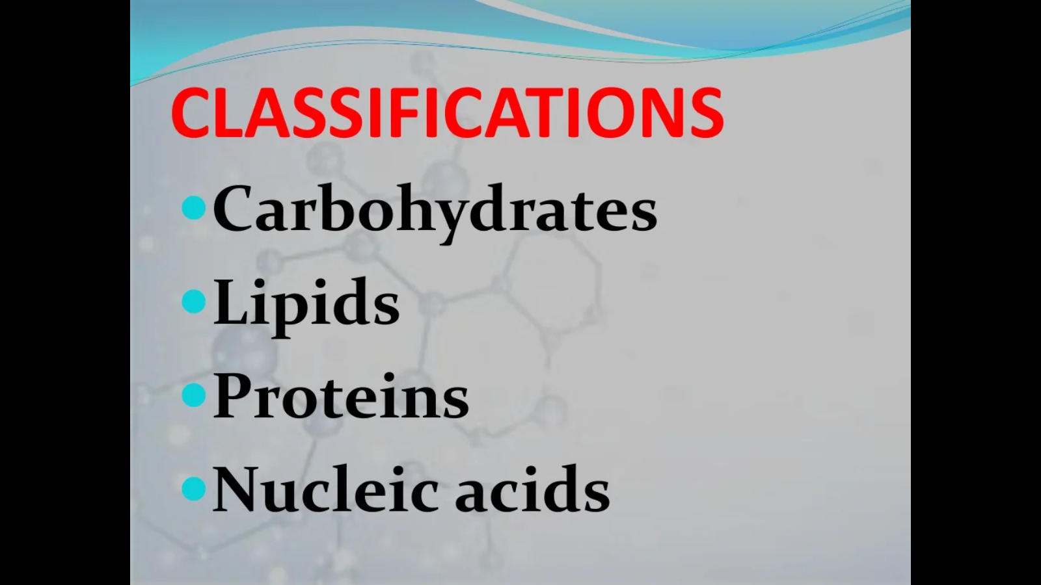

Slide 4
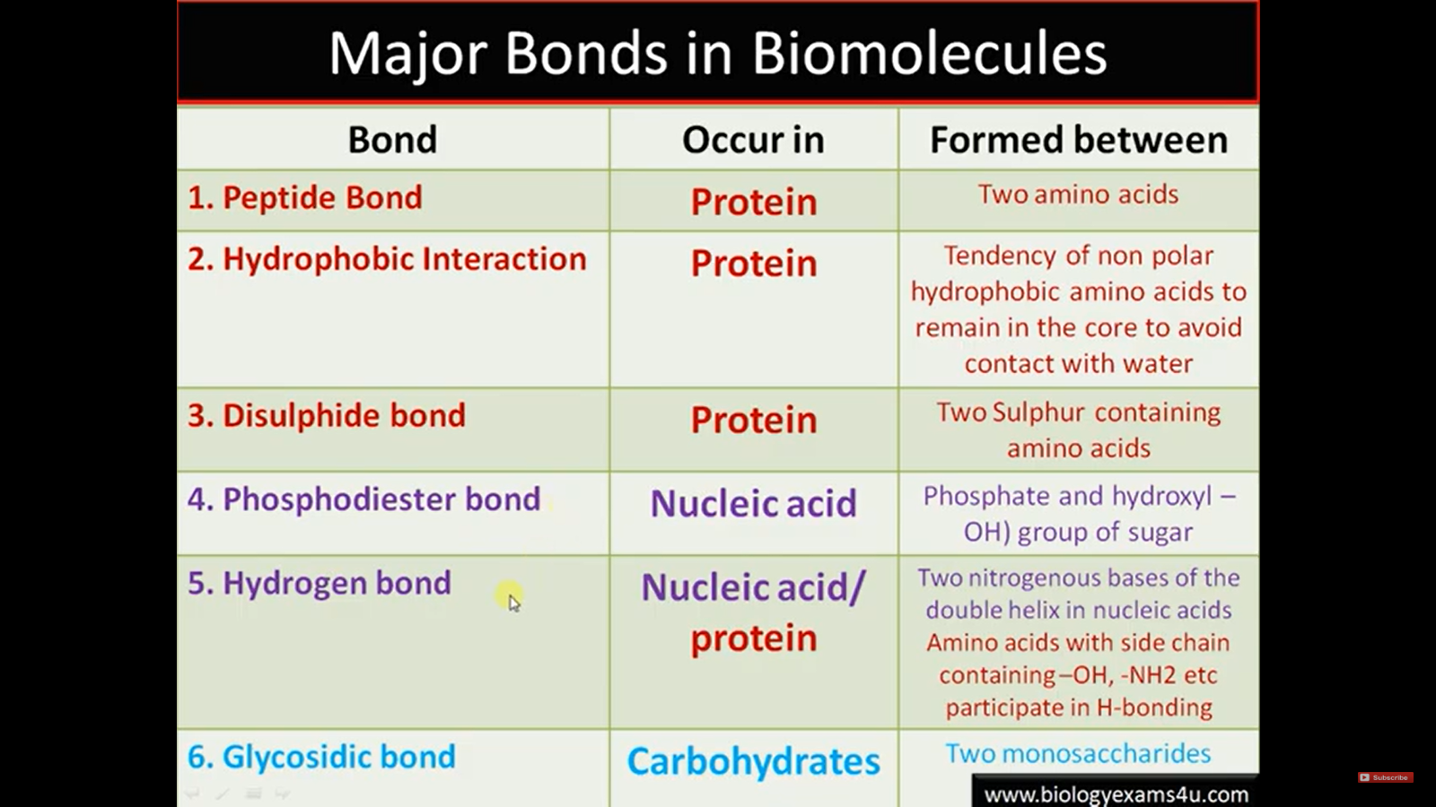

Slide 5
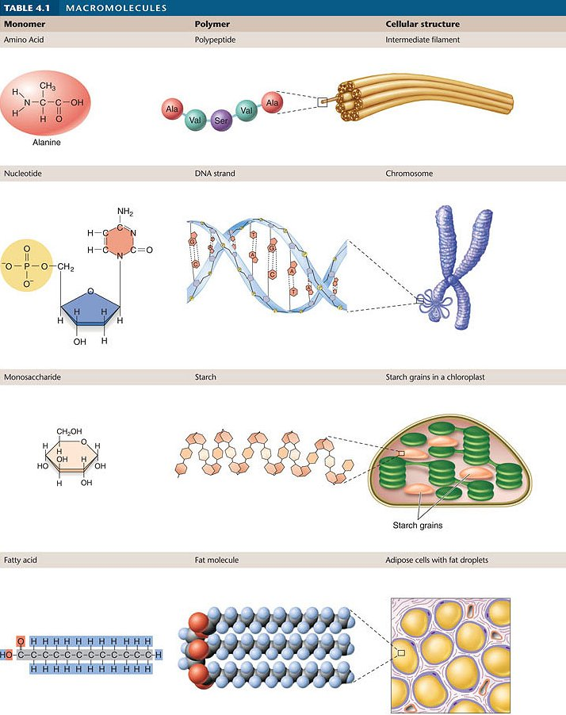
Large Biological Molecules
Critically important molecules in all living things divided into 4 classes:
Lipids (fats)
Carbohydrates (sugars)
Proteins
Nucleic Acids (DNA & RNA)
Carbs, Proteins and Nucleic Acids are Polymers
http://www.yellowtang.org/images/joh86670_t04_01.jpg

Slide 6
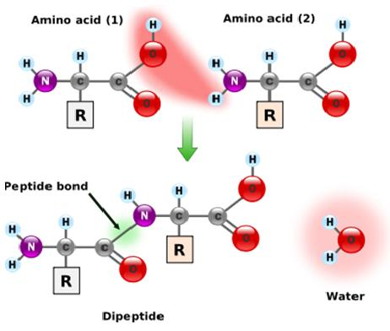
Polymers are built from Monomers
Polymers (large) are made of covalently bonded monomers (building blocks)
Polymers built by dehydration synthesis
Polymers broken into monomers by hydrolysis
The order of the monomer determines the function and shape of the polymer.

Slide 7
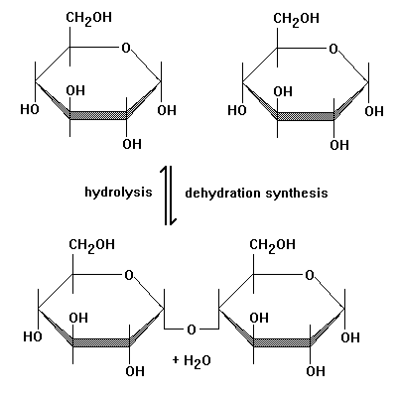
Hydrolysis & Dehydration synthesis
Hydrolysis
Breaks bonds in a polymer by adding water
Dehydration Synthesis
Bond forms between 2 monomers & a water molecule is lost
Facilitated by enzymes

Slide 8
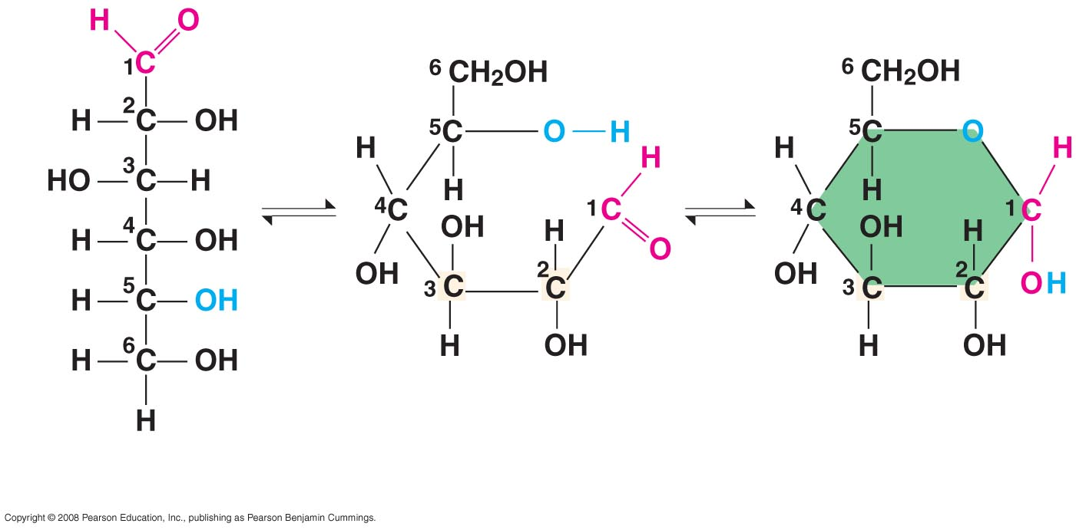
Carbohydrates, fuel & building material
Carbon & water CH₂O w/ a 2:1 ratio of H to O
Can exist as a ring or linear, notice the numbering of the Carbon atoms. Start at the top of a chain & to the right of a ring.

Slide 9
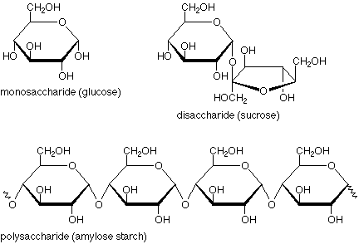
Monosaccharides: simple sugars
Monosaccharides generally have molecular formulas that are some multiple of the unit CH₂O.
Glucose has the formula C₆H₁₂O₆. Quick energy for cells
Monosaccharides: one ring structure
Disaccharides: 2 ring structure
Polymer: many rings
Most names for sugars end in –ose.
Glucose, an aldose, and fructose, a ketose, are structural isomers.
Monosaccharides are also classified by the number of carbons in the carbon skeleton

Slide 10
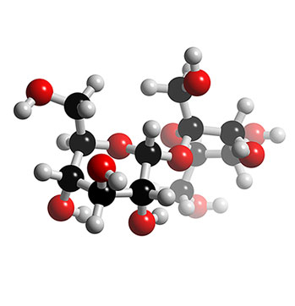
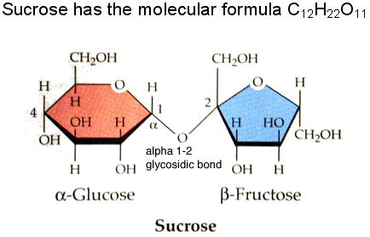
Disaccharides
Consist of 2 monosaccharides joined by a glycosidic linkage (covalent bond formed by dehydration synthesis)
Glucose + fructose= sucrose
Glucose + galactose = lactose
http://www.3dchem.com/imagesofmolecules/Sucrose.jpg
http://www.chm.bris.ac.uk/motm/glucose/sucrose.gif

Slide 11
Polysaccharides
Polysaccharides – many saccharides
Energy storage (alpha glucose) - helical
Starch – plants
Amylose - unbranched
Amylopectin - branched
Glycogen – animals, liver and muscle energy stores
Structure and support (beta glucose) – straight
Cellulose – plants, structural support creates a cable like structure called microfibrils by H-bonding to adjacent cellulose molecules
Chitin – exoskeletons and fungi
Contains nitrogen

Slide 12
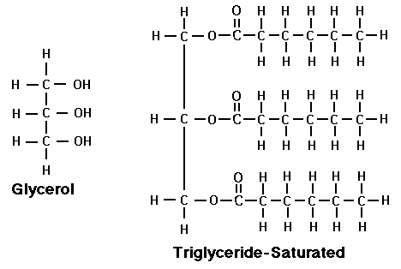
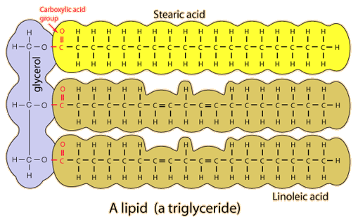
Lipids: not a polymer or a macromolecule
Lipids are hydrophobic, mostly hydrocarbons with non-polar covalent bonds
In a fat, three fatty acids are joined to glycerol = triglyceride
Glycerol: an alcohol with 3 carbons each with a hydroxyl group
http://www.raw-milk-facts.com/images/GlycerolTrigly.gif

Slide 13
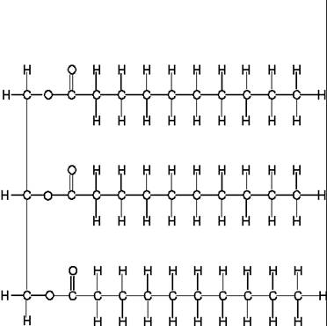
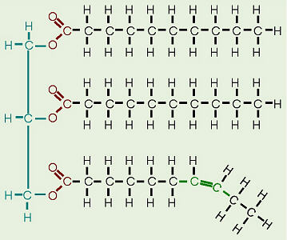
Saturated vs. Unsaturated Fats
Saturated Fats:
Have all single bonds between C atoms, solid at room temperature
Unsaturated Fats:
Have double or triple bonds between C atoms, liquid at room temperature
http://www.highperformanceliving.com/assets/images/cid_image002.jpg
http://biology.clc.uc.edu/graphics/bio104/fat.jpg

Slide 14
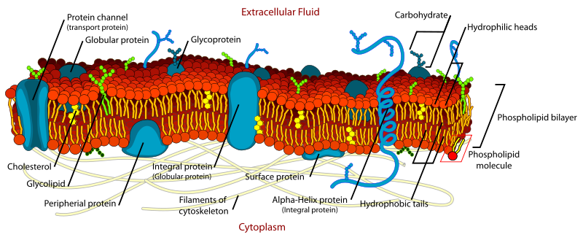
Fats and Cell Membranes
In a phospholipid, two fatty acids and a phosphate group are attached to glycerol: the main component of cell membranes
The two fatty acid tails are hydrophobic, but the phosphate group and its attachments form a hydrophilic head
http://cellbiology.med.unsw.edu.au/units/images/Cell_membrane.png

Slide 15
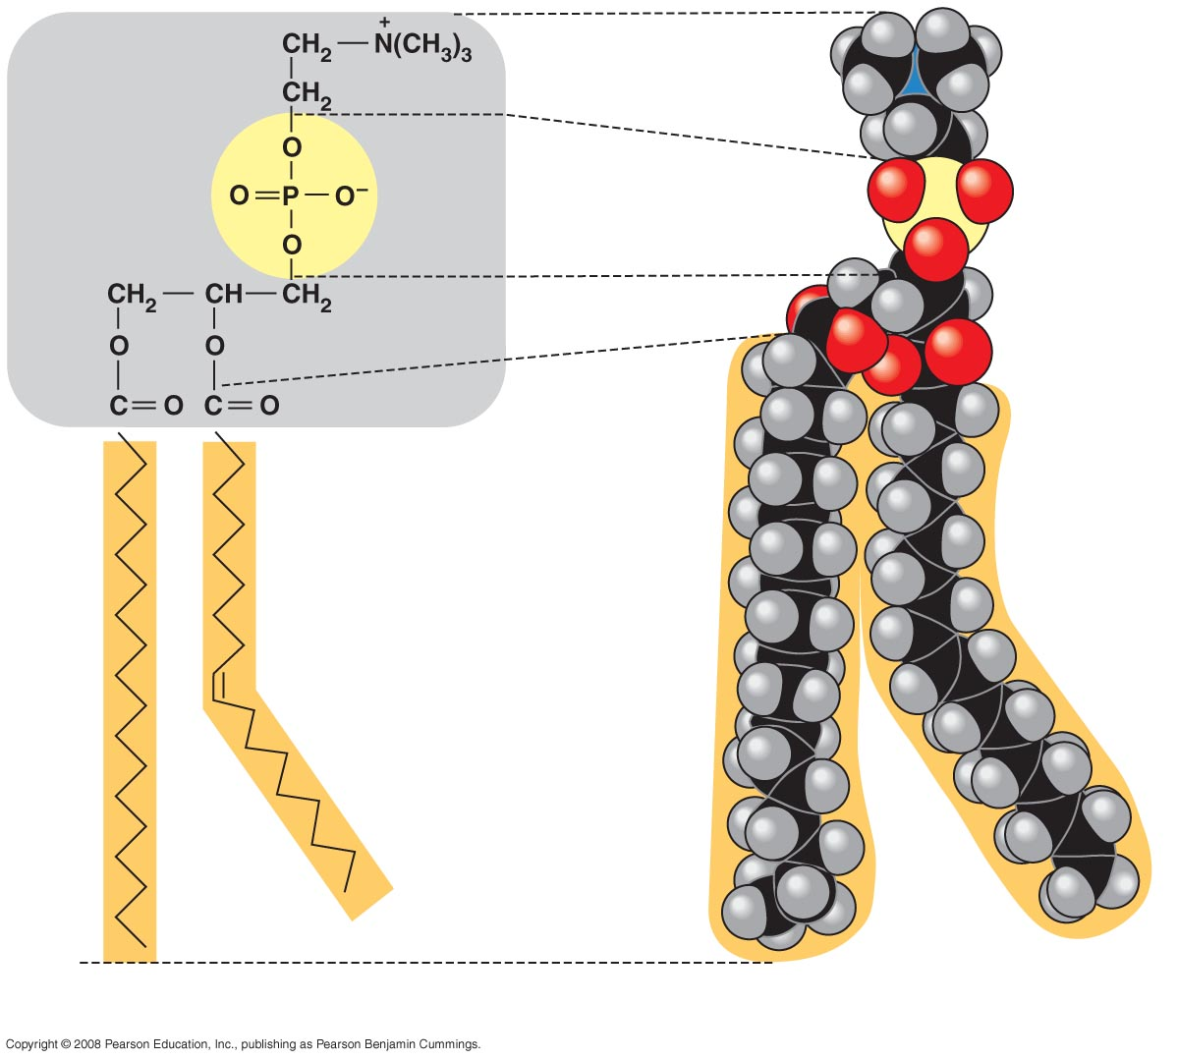
Fig. 5-13ab
Choline
Hydrophilic head
Phosphate
Glycerol
Fatty acids
Hydrophobic tails
(a)
Structural formula
(b)
Space-filling model
Notes:
Figure 5.13 The structure of a phospholipid

Slide 16
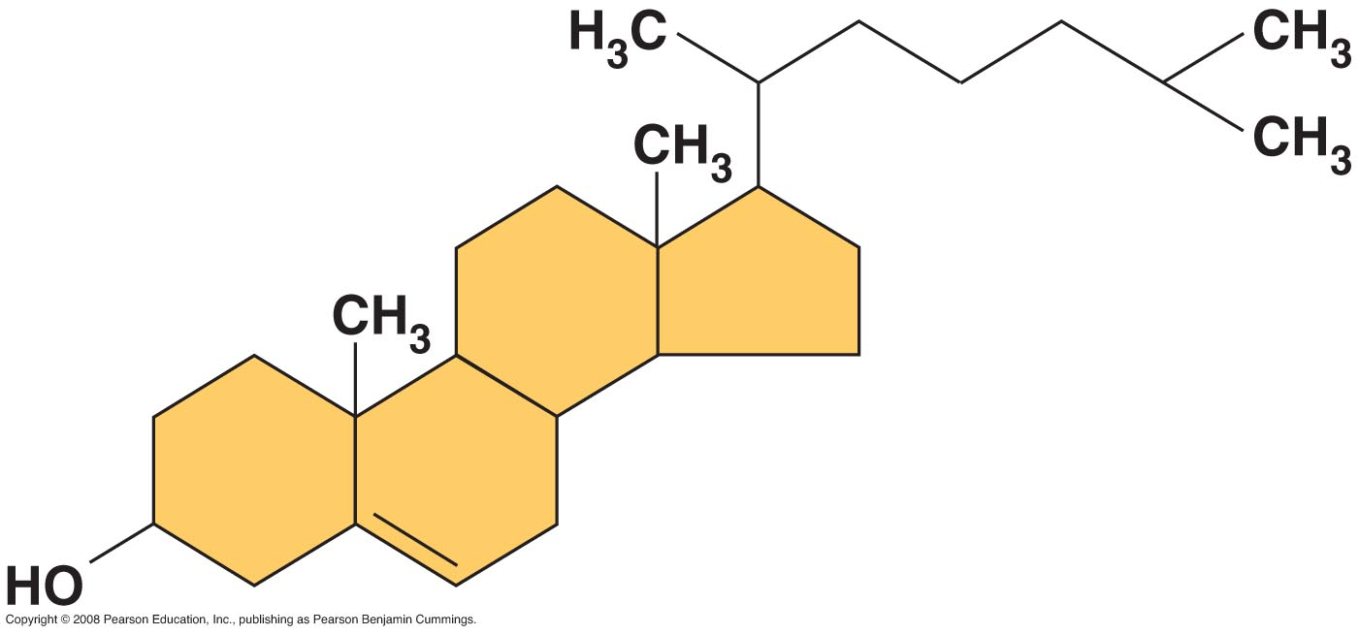
Steroids
Lipids characterized by a carbon skeleton of 4 fused rings
Cholesterol and many other hormones important in cell membranes
Too much builds up in the arteries = atherosclerosis
Trans fats: artificially made fats, no enzymes to break them down = heart disease
cholesterol

Slide 17
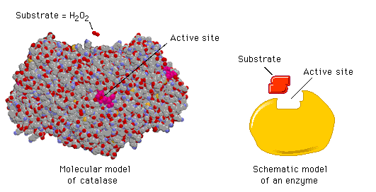
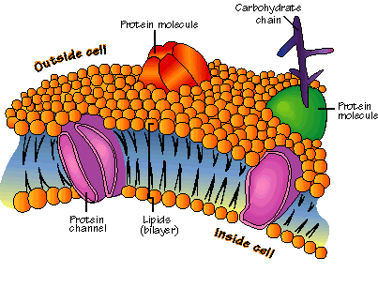
Proteins
Enzymes – catalysts
Structural support
Storage
Transport
Cell communication
Movement
Defense

Slide 18
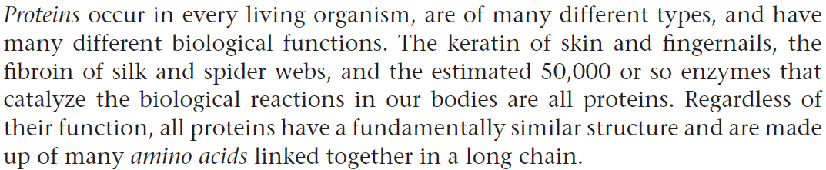
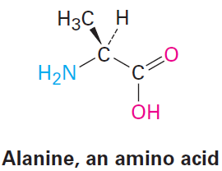
Biomolecules
Proteins
Q1. What are proteins?
Q2. What are amino acids? Why are they called difunctional?
Q3. Draw the structure of an amino acid.

Slide 19
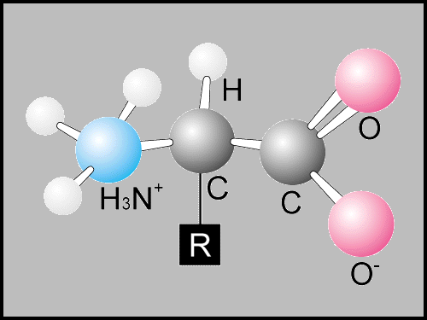
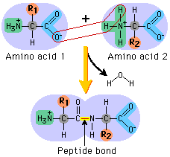
Proteins
Protein – made of one or more polypeptides
Polypeptide – polymer of amino acids joined by peptide bonds amino acids are alternately flipped upside down
Amino acid – contains an amine group and a carboxyl group
20 different
Differ in properties due to R groups or side chains
http://www.schenectady.k12.ny.us/putman/biology/data/images/translation/peptbond.gif

Slide 20
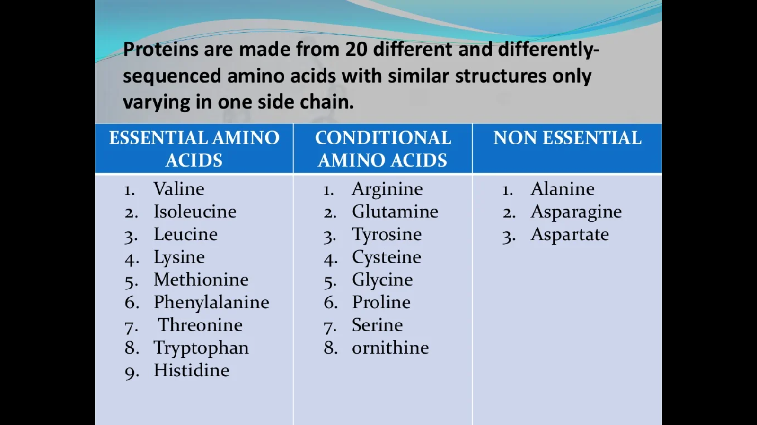

Slide 21
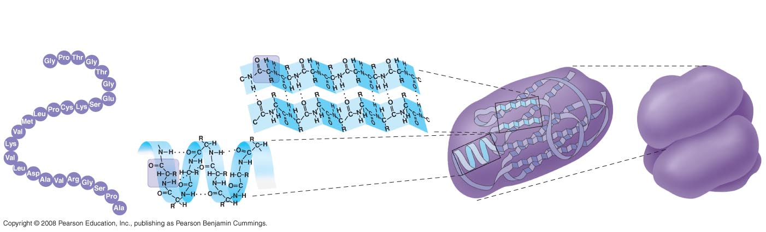
Protein Structure Protein Folding Animation
Primary: Amino Acid Sequence
Secondary: α helix or β pleated sheet (H bonds between a.a.)
Tertiary: the folding of the secondary structure 3-D due to hydrogen bonds and disulfide bridges
Quaternary: 2 or more polypeptide chains put together by chaperone proteins (errors in folding cause disease: Alzheimer’s and Parkinson’s, sickle cell anemia)
Primary
Structure
Secondary
Structure
Tertiary
Structure
Quaternary
Structure

Slide 22
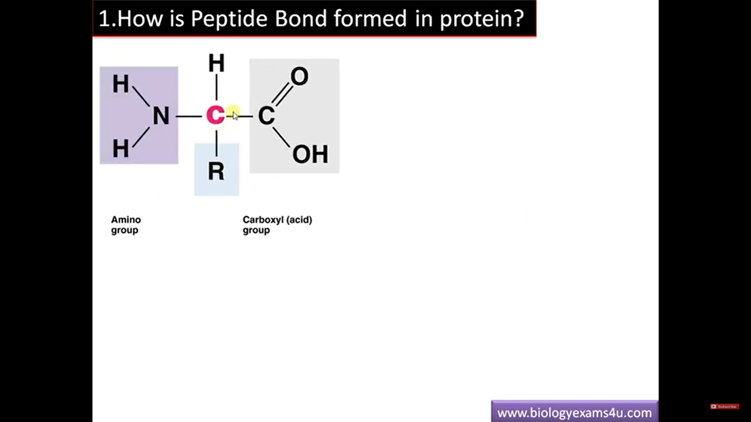

Slide 23
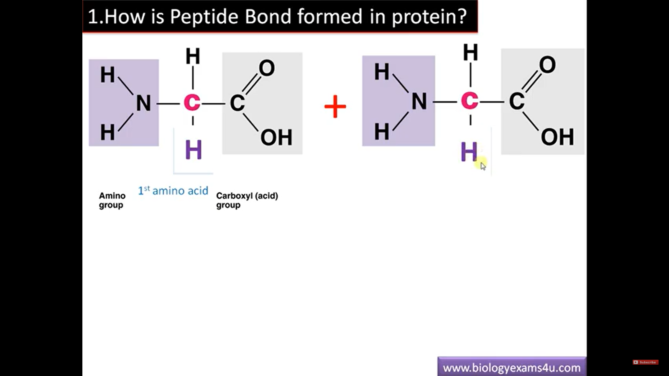

Slide 24
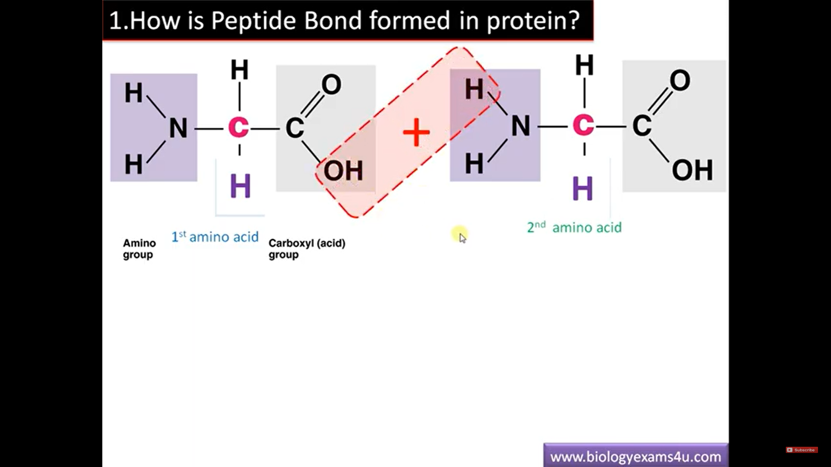

Slide 25
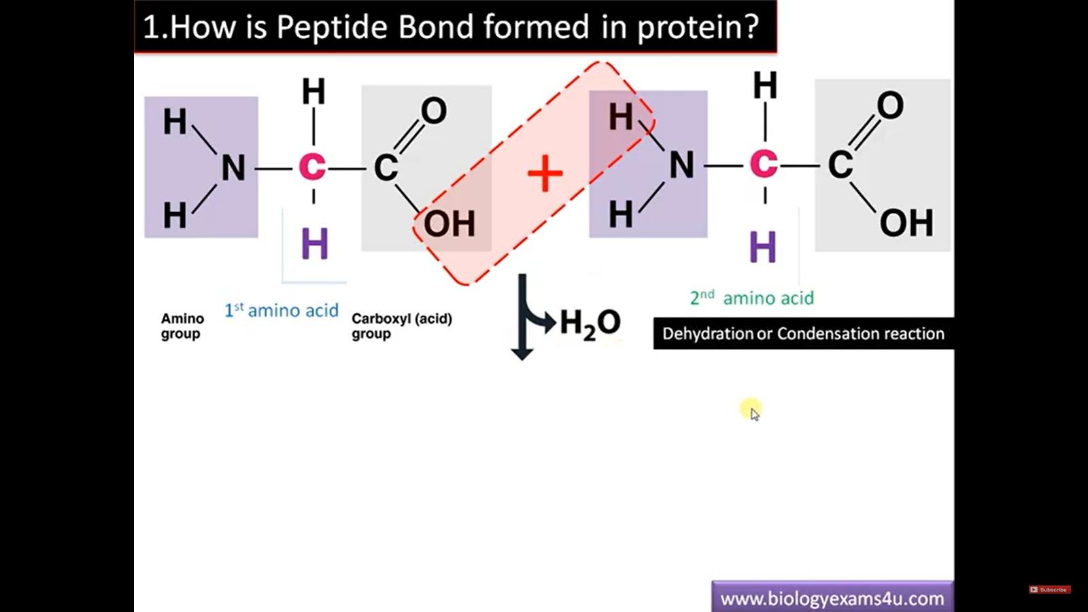

Slide 26
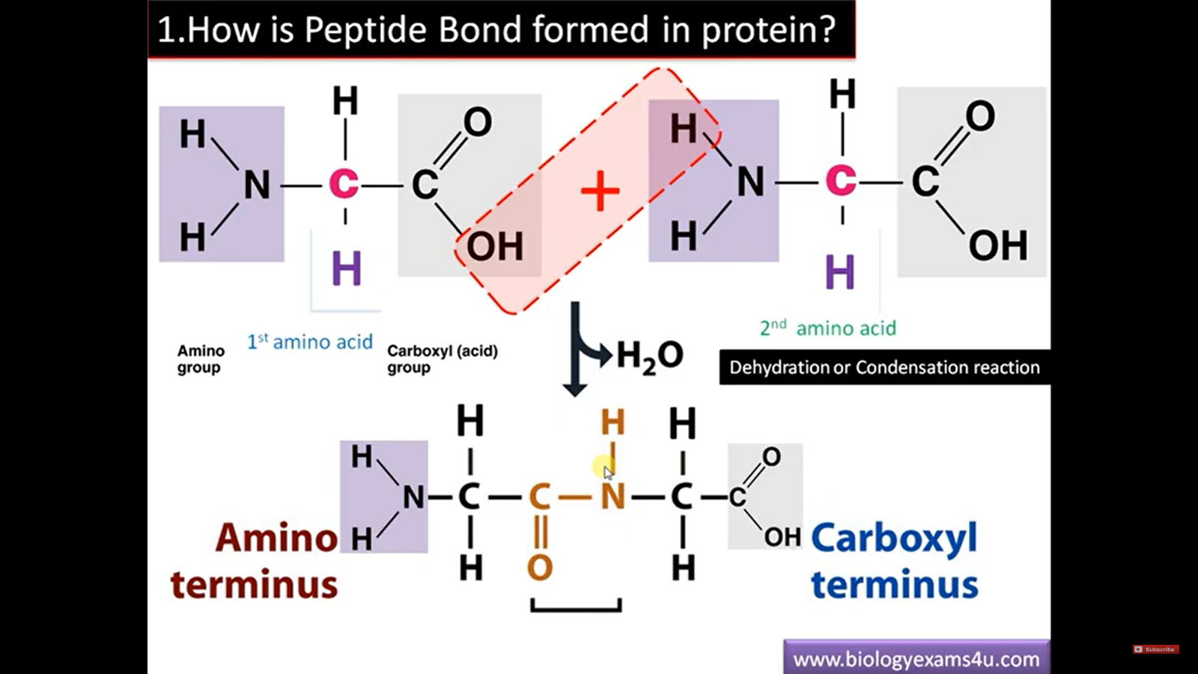

Slide 27
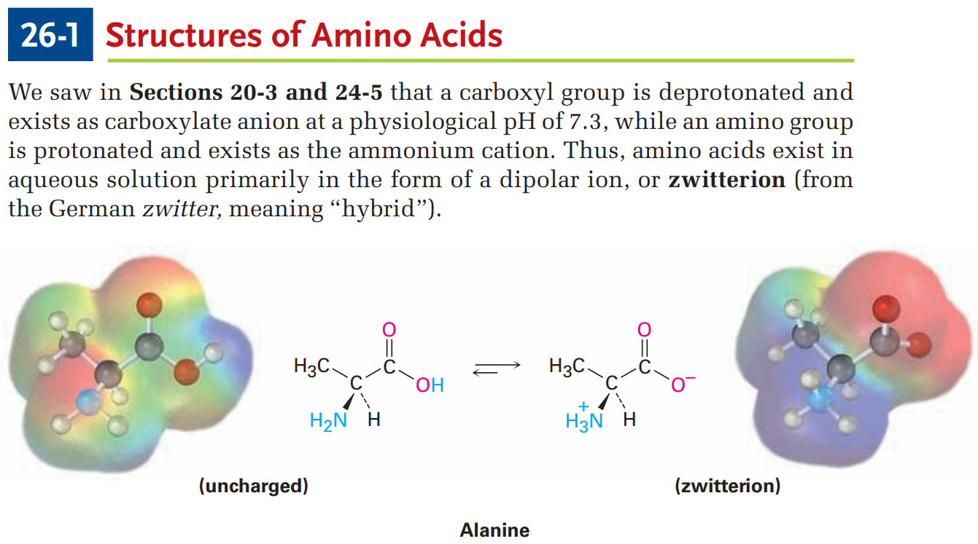
Biomolecules
Amino Acids as Zwitterions
Q1. What are zwitterions? Give example.

Slide 28
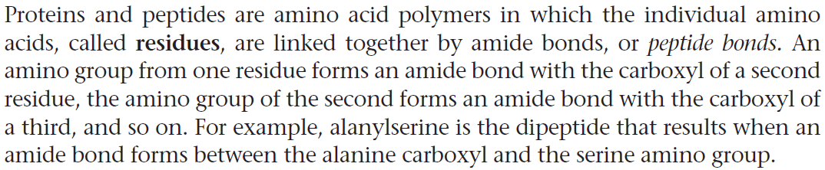
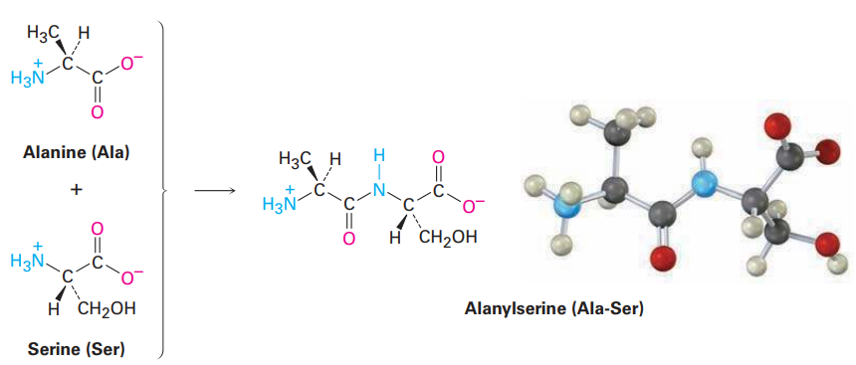
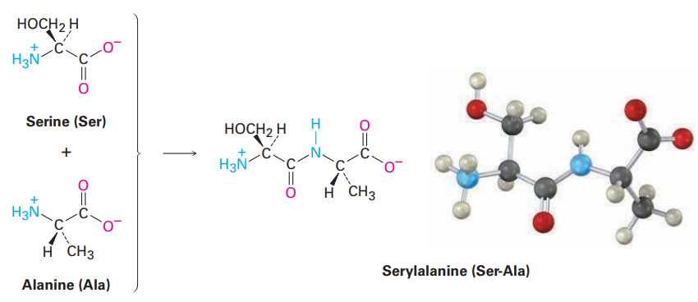
Biomolecules
Peptides
Q1. What are peptide bonds?
Q2. Give an example of the formation of a peptide bond.

Slide 29
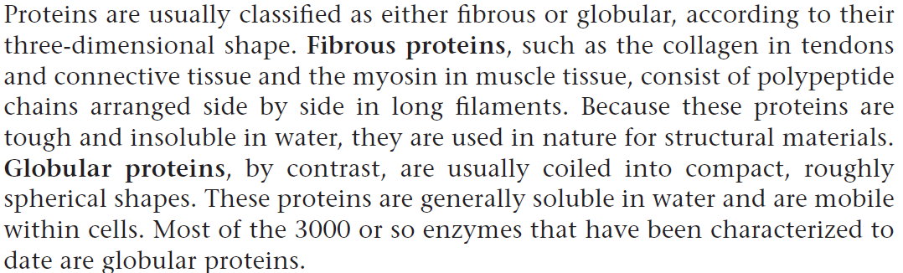
Biomolecules
Proteins
Q1. How proteins are usually classified?
Q2. What are fibrous and globular proteins? Give examples.

Slide 30
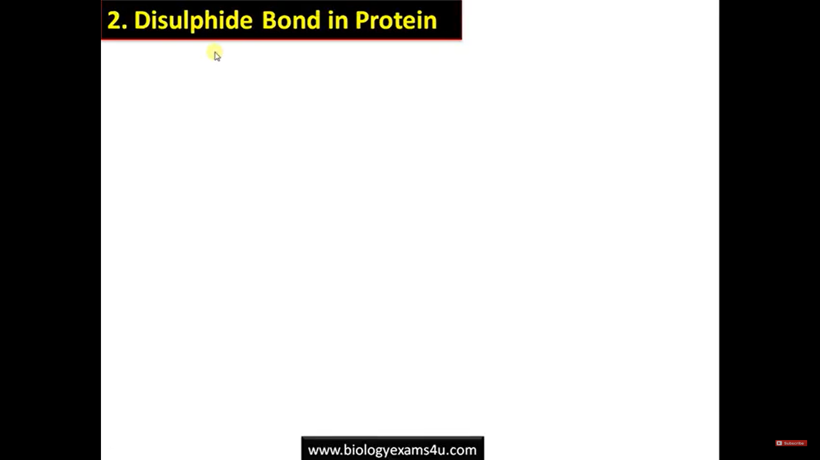

Slide 31
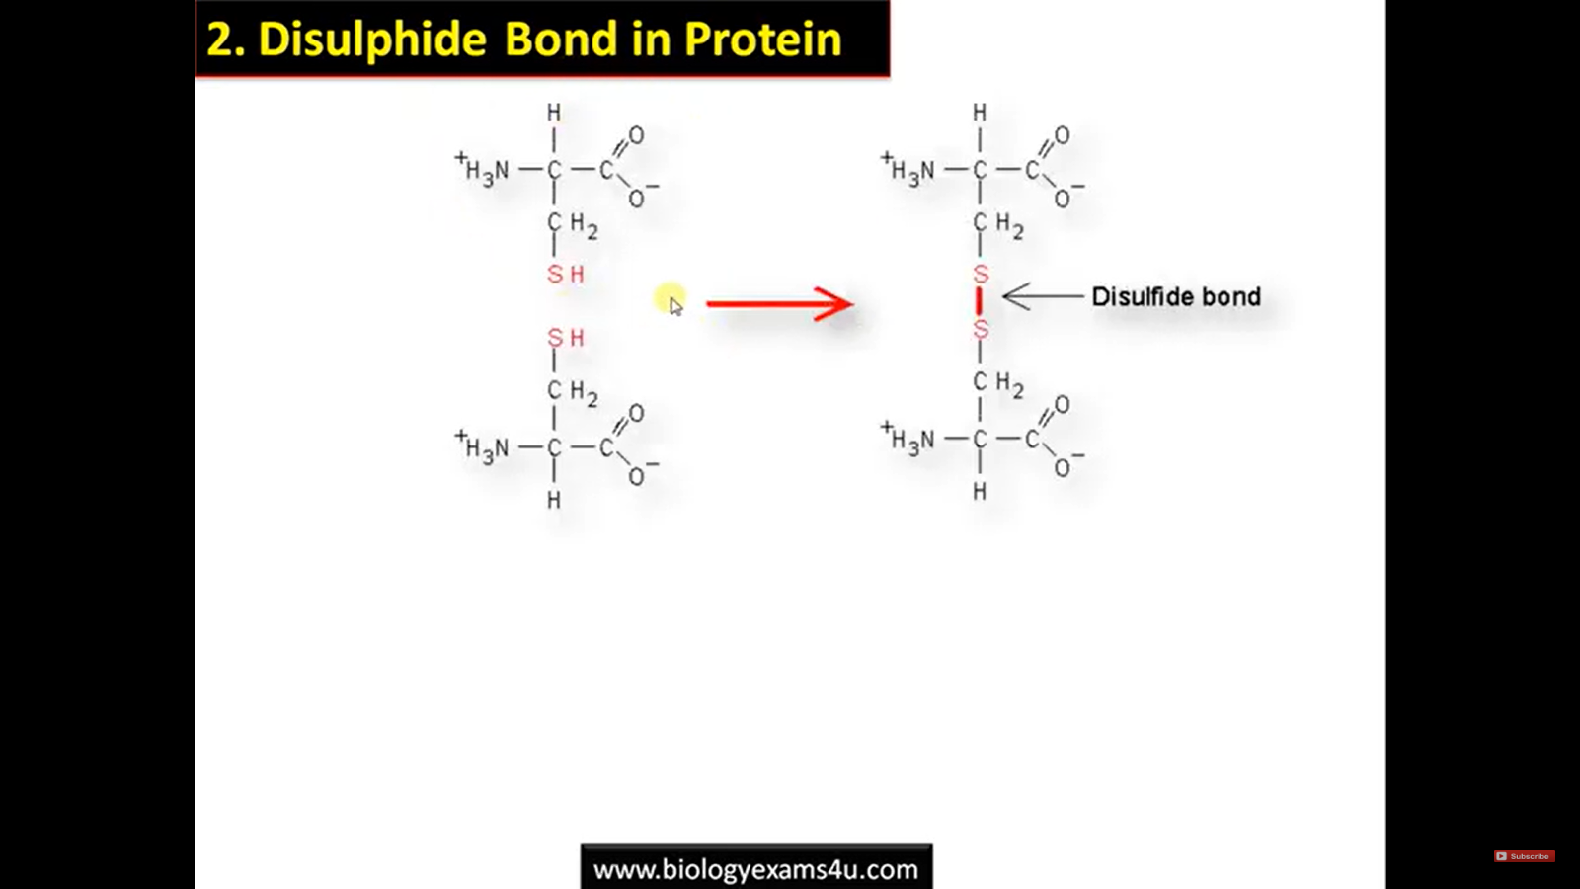

Slide 32
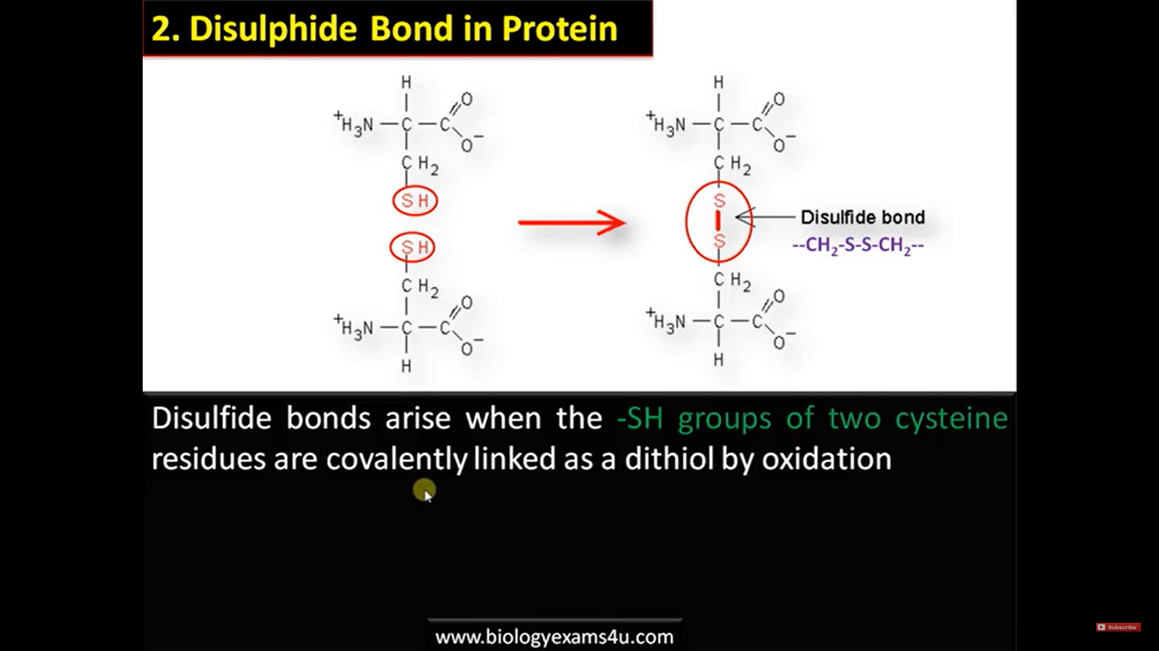

Slide 33


Slide 34
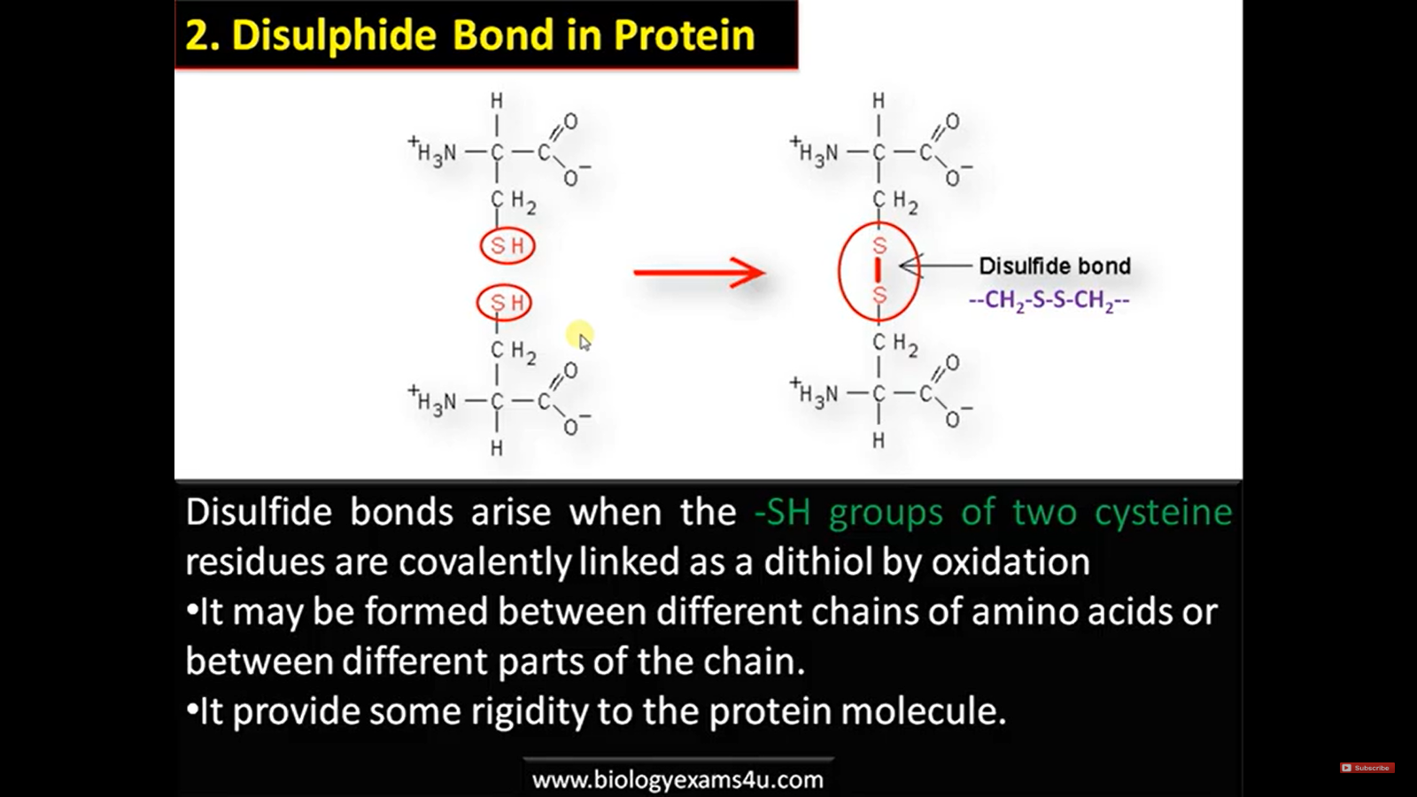

Slide 35
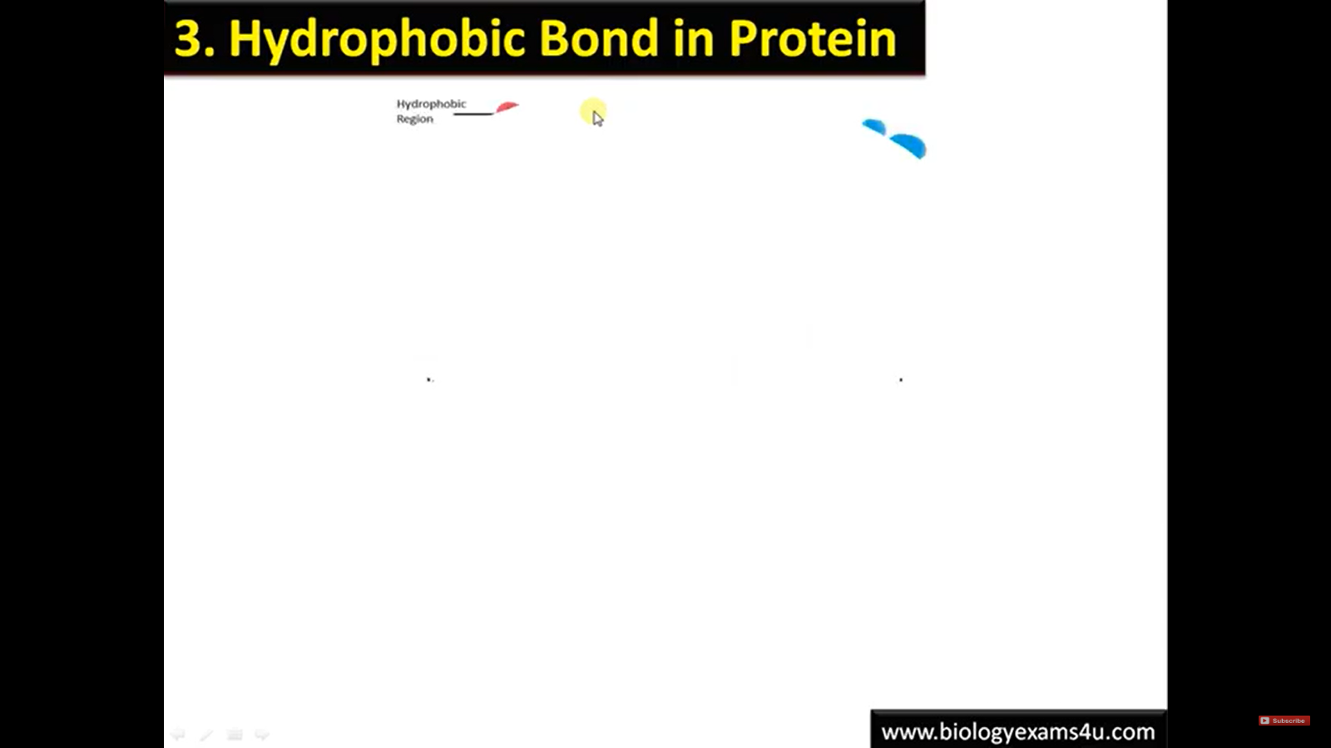

Slide 36
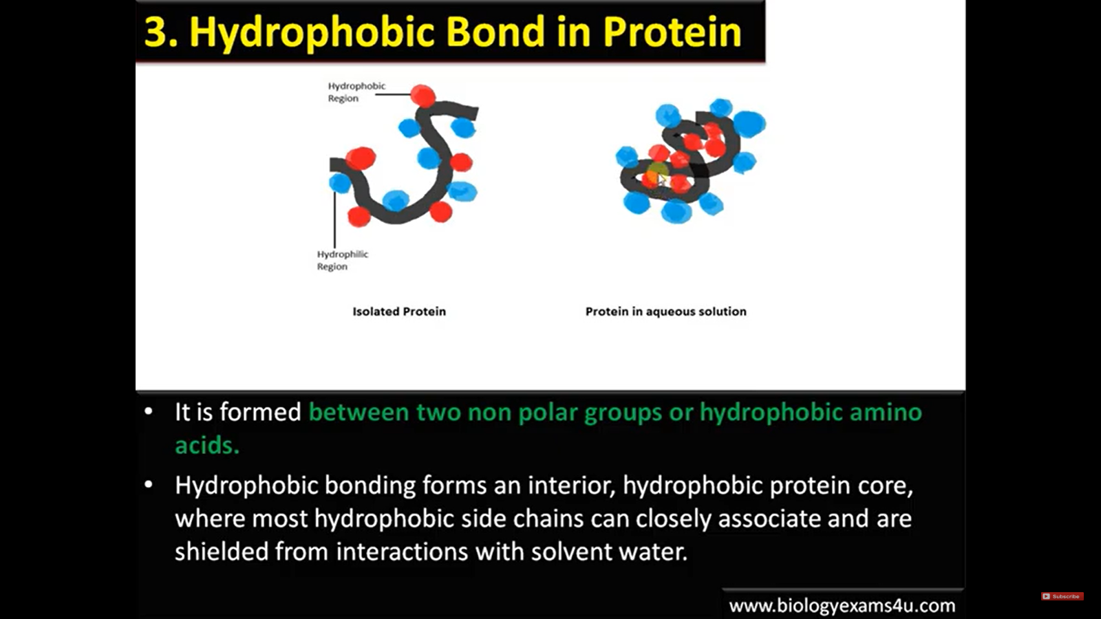

Slide 37
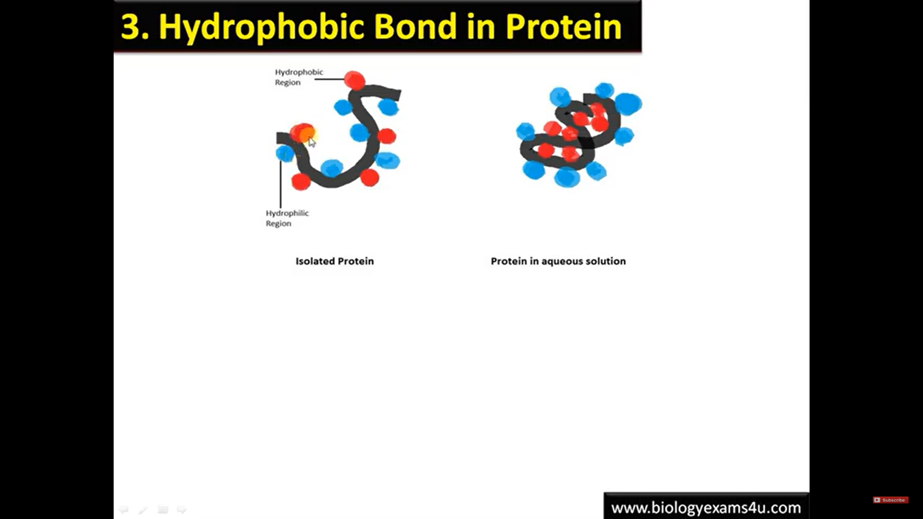

Slide 38
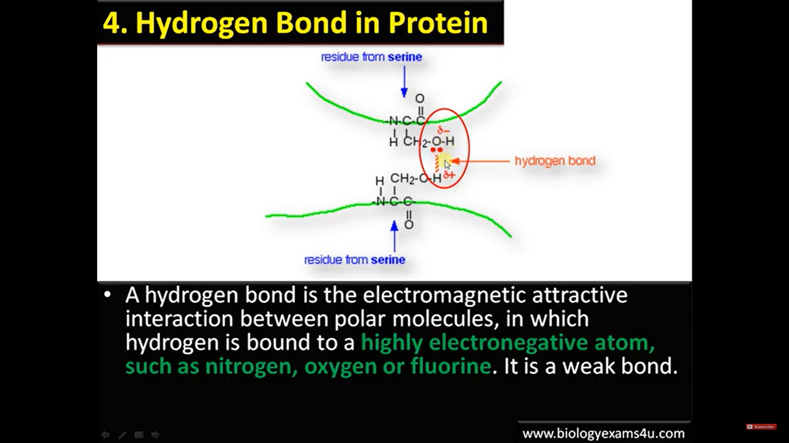

Slide 39
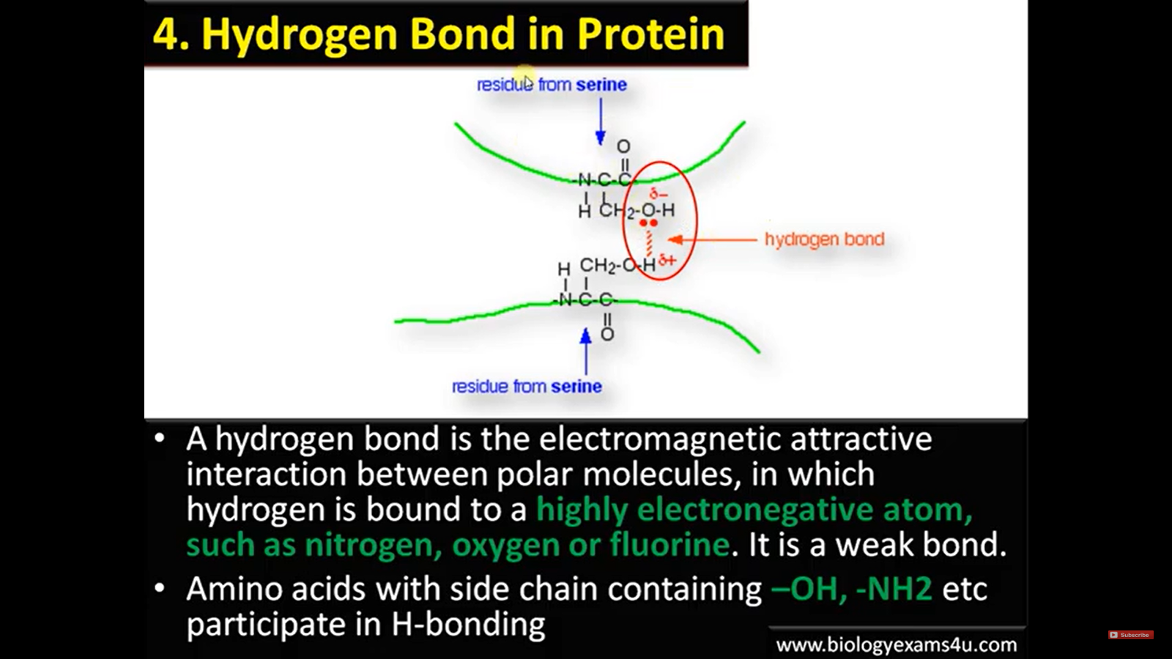

Slide 40

https://fold.it/portal/node/2003714
Download and install Foldit
Foldit runs on Windows (all versions since XP), macOS (10.7 or later), and Linux (64-bit).

Slide 41
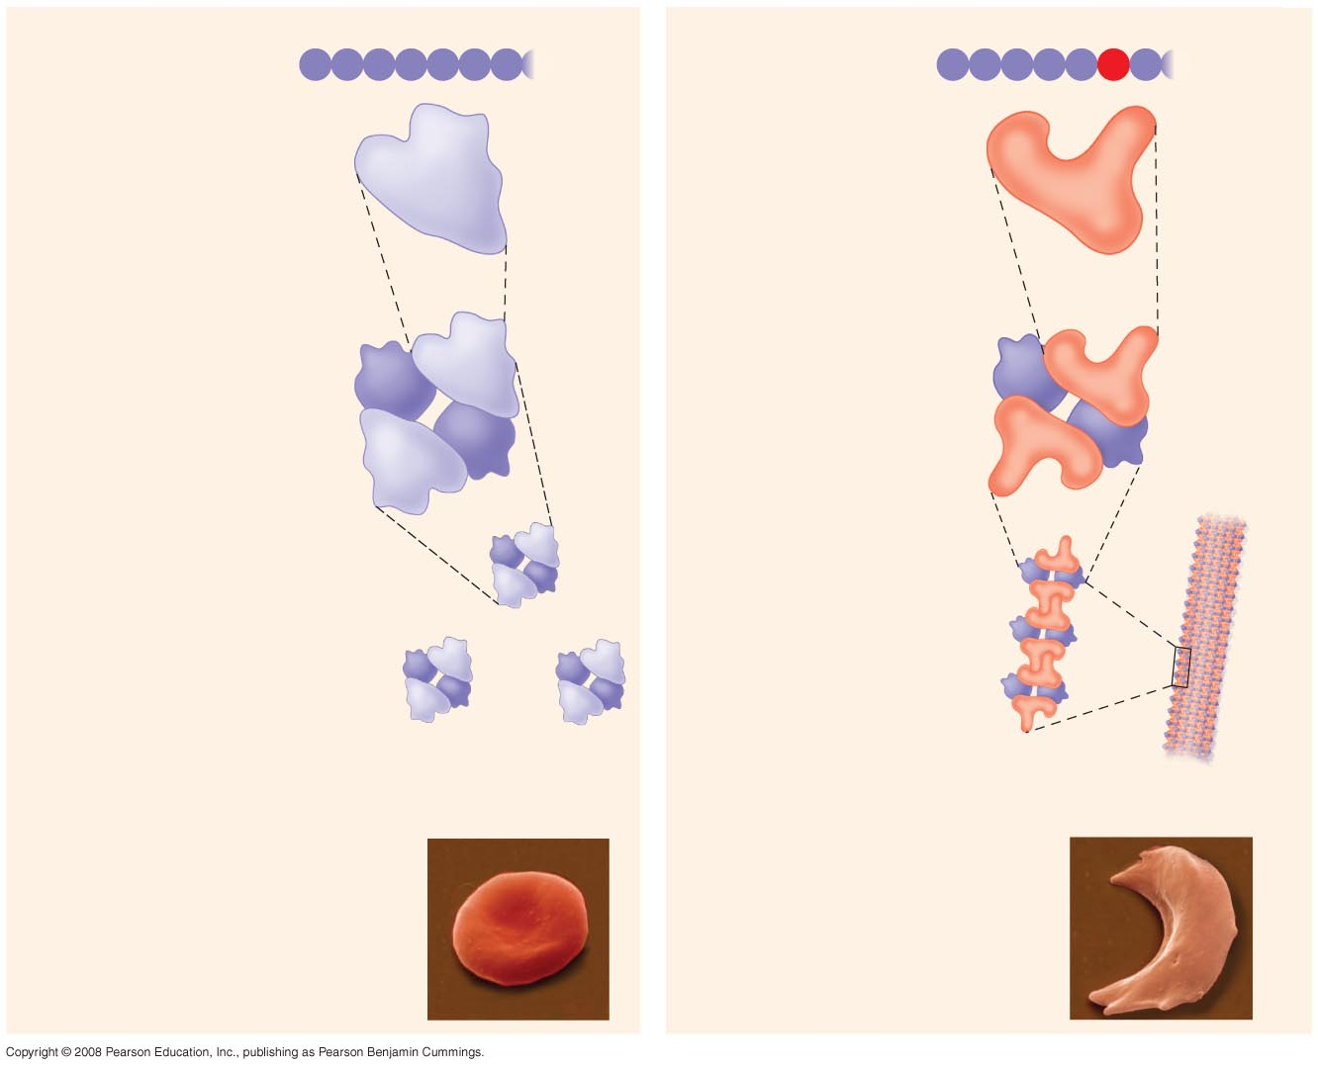
Fig. 5-22
Normal hemoglobin
Primary
structure
Sickle-cell hemoglobin
Primary
structure
Val
His
Leu
Thr
Pro
Glu
Glu
Val
His
Leu
Thr
Pro
Val
Glu
1
2
3
4
5
6
7
1
2
3
4
5
6
7
Secondary
and tertiary
structures
Secondary
and tertiary
structures
Exposed
hydrophobic
region
 subunit
 subunit



Quaternary
structure
Normal
hemoglobin
(top view)
Quaternary
structure
Sickle-cell
hemoglobin





Function
Molecules do
not associate
with one
another; each
carries oxygen.
Function
Molecules
interact with
one another and
crystallize into
a fiber; capacity
to carry oxygen
is greatly reduced.
10 µm
10 µm
Red blood
cell shape
Normal red blood
cells are full of
individual
hemoglobin
moledules, each
carrying oxygen.
Red blood
cell shape
Fibers of abnormal
hemoglobin deform
red blood cell into
sickle shape.
Notes:
Figure 5.22 A single amino acid substitution in a protein causes sickle-cell disease

Slide 42
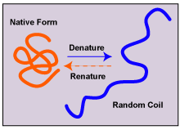
Proteins
Denaturation – the unfolding of a protein
Depends on chemical and physical conditions
pH, Ionic concentration, temperature
Chaperonins – aid in the folding process

Slide 43
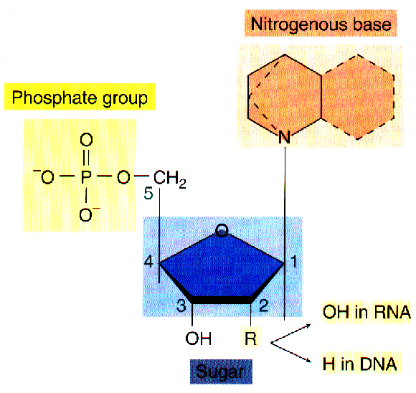
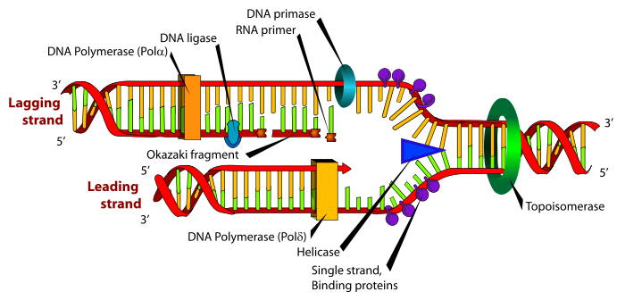
Nucleic Acids
Genes - Store and transmit genetic information and are made of nucleic acids
DNA – deoxyribonucleic acid
RNA – ribonucleic acid
Proteins are made from info in nucleic acids
Nucleotides are the monomers of nucleic acids
Sugar
Ribose
Deoxyribose
Phosphate
Base
Purines - AG
Pyrimadines - CT
Nucleotide
DNA replication
http://lams.slcusd.org/pages/teachers/saxby/wordpress/wp-content/uploads/2009/11/DNA_replication_fork1.png

